Slide 1
Summons in Civil Cases
Prepared by:
Imtiaz Ullah Khan
Civil Judge XIII/JMIC
Mansehra

Slide 2
INTRODUCTION
It is a well known principle of natural justice
AUDI ALTERAM-PARTEM that no one should be condemned un-heard.
The main theme behind issuance of summon is that the other party must know the proceedings initiated against him/them by the court.

Slide 3
DEFINITION OF SUMMON
A summon is written, signed and sealed order of the court by which the court requires presence of a person before court, either in-person or through agent or pleader on a specific day.

Slide 4
PURPOSE & OBJECTIVE OF SUMMONS
Purpose and objective of summons is to inform the defendant of proceedings so that he can appear before the court and be heard or any defense he may wish to put at the same time.
PLD 2012 Sindh-78

Slide 5
ESSENTIALS OF SUMMONS
It must be written.
It must be signed by the judge or officer empowered by the judge in this behalf.
It must be sealed.

Slide 6
WHY SUMMONS ARE ISSUED?
A summon is issued because it is a principle of natural justice that no one should be condemned unheard and so that the defendant could have information of the proceedings against him and a right to defend himself by filing written statement so that he could prepare himself.

Slide 7
WHEN SUMMONS MAY NOT ISSUED?
When a suit is filed and defendant is present in the court and admits the plaintiff’s claim.

Slide 8
PROVISIONS OF SERVICE OF SUMMON IN THE CPC
Section 27 to 32 & Order V, XVI of CPC deal with the issuance of the summons.
Order V CPC deals with the issuance of summons when suit is duly filed.
Order XVI deals with the issuance of summons to witnesses.

Slide 9
KINDS OF SUMMONS
There are two kinds of Summons:
1) For Settlement of Issues.
For normal trial of the case
2) For Final Disposal of the Case.
Summons for final disposal of the case issued when a case could be decided summarily.

Slide 10
MODES OF SERVICE OF SUMMONS
Order V CPC.
Postal service. (Registered Post through postal service not covered through TCS, Leopard Carrier etc)
Personal service. (through court agent when the person is residing in the court jurisdiction of that court)
Substituted service/Alternate Mode. If all other modes fails,
1) Affixation of a summon at a prominent place.
2) Electronic Devices-Phone-Radio-TV-Whatsapp etc.
3) Ums-Urgent Mail service- TCS.
4) Beat of Drum.
5) Publication in press or any other manner in CPC (26-A amendment) .

Slide 11
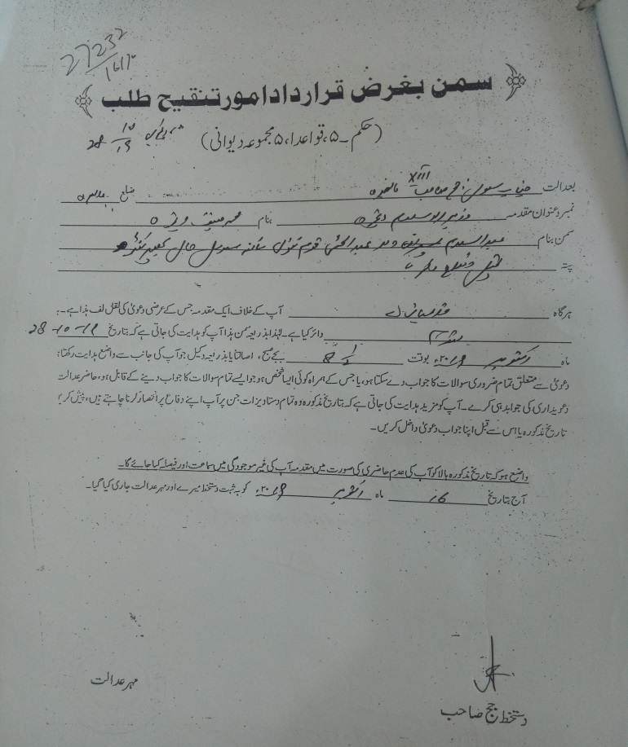
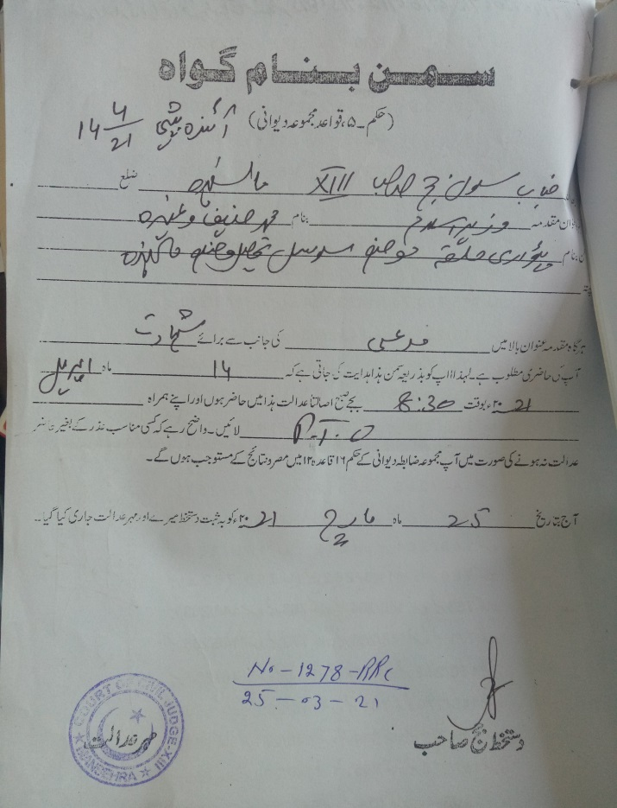
Types of SUMMONS
Summon against Defendant.
Summon against witness.

Slide 12
SUMMONS TO WITNESSES
Order XVI.
After settlement of issues, parties have to sub it their list of witnesses within 07 days in the court.
According to the said list, witnesses would be called by the court to appear and to give evidence in the support of the claim of the parties.
Expenses of Witness (official) the party wishes to give evidence in favor of its claim has to deposit expenses for the same.
After receiving the summon being a witness, if a person failed to appear before the court, the court may issue warrant against the said witness.

Slide 13
CONSEQUENCES UNDER LAW
Ex-Parte Proceedings. ( against the defendant, in case of positively service).
Warrant of arrest (against a witness, after positive service)
Attach and sale his property (against witness)
Impose fine upon him (not exceeding Rs. 2000/-)
Direction to furnish security for his appearance and in default can commit to civil prison.

Slide 14
CONCLUSION
Summon plays a pivotal role in the administration of justice. The defendant should have information of the claim against him. Defendant should have an opportunity to defend himself of the claim made against him. The plaintiff should timely submit the summons as directed by the court, so that the speedy and undelay justice may be dispensed with.

Slide 15
THANKS

